Slide 1
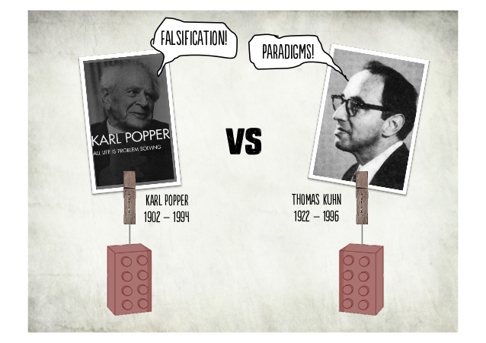
Popper vs Kuhn
Is there a debate?

Slide 2
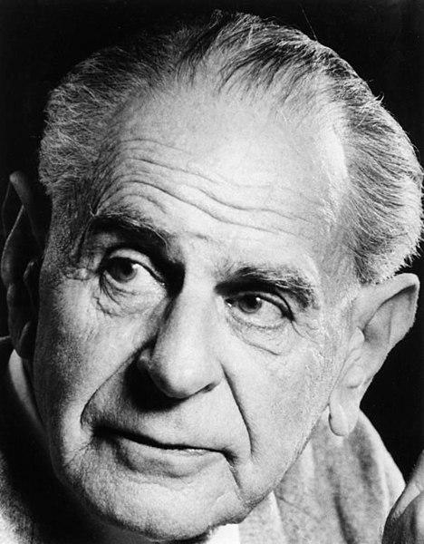
Sir Karl Popper
Professor of Logic and Scientific Method
London School of Economics
1902-1994

Slide 3
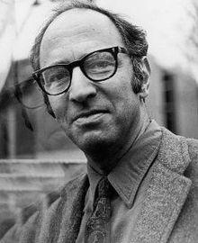
Thomas Kuhn
Professor of History of Science
University of California, Berkeley
1922-1996

Slide 4
The problem of Demarcation
The demarcation problem in the philosophy of science and epistemology is about how to distinguish between science and non-science, including between science, pseudoscience, and other products of human activity, like art and literature, and beliefs.
"The problem of finding a criterion which would enable us to distinguish between the empirical sciences on the one hand, and mathematics and logic as well as 'metaphysical' systems on the other, I call the problem of demarcation." - Karl Popper
https://www.youtube.com/watch?v=ZwbkRyopBEQ

Slide 5
The purpose of demarcation
From a practical point of view, the distinction is important for decision guidance in both private and public life. Since science is our most reliable source of knowledge in a wide variety of areas, we need to distinguish scientific knowledge from its look-alikes. Due to the high status of science in present-day society, attempts to exaggerate the scientific status of various claims, teachings, and products are common enough to make the demarcation issue pressing in many areas.
Further we will show some examples.

Slide 6
Healthcare: Medical science develops and evaluates treatments according to evidence of their effectiveness. Pseudoscientific activities in this area give rise to ineffective and sometimes dangerous interventions. Healthcare providers, insurers, government authorities and – most importantly – patients need guidance on how to distinguish between medical science and medical pseudoscience.
Expert testimony: It is essential for the rule of law that courts get the facts right. The reliability of different types of evidence must be correctly determined, and expert testimony must be based on the best available knowledge. Sometimes it is in the interest of litigants to present non-scientific claims as solid science. Therefore courts must be able to distinguish between science and pseudoscience. Philosophers have often had prominent roles in the defence of science against pseudoscience in such contexts.
Environmental policies: In order to be on the safe side against potential disasters it may be legitimate to take preventive measures when there is valid but yet insufficient evidence of an environmental hazard. This must be distinguished from taking measures against an alleged hazard for which there is no valid evidence at all. Therefore, decision-makers in environmental policy must be able to distinguish between scientific and pseudoscientific claims.

Slide 7
Kuhn’s stance
Finally, and this is for now my main point, a careful look at the scientific enterprise suggests that it is normal science, in which Sir Karl’s sort of testing does not occur, rather than extraordinary science which most nearly distinguishes science from other enterprises. If a demarcation criterion exists (we must not, I think, seek a sharp or decisive one), it may lie just in that part of science which Sir Karl ignores.
— Thomas S. Kuhn, "Logic of Discovery or Psychology of Research?"
Thomas Kuhn is often connected with what has been called postpositivism or postempiricism. In his 1962 book The Structure of Scientific Revolutions, Kuhn divided the process of doing science into two different endeavors, which he called normal science and extraordinary science (which he sometimes also called "revolutionary science"). Kuhn thinks "we must not seek a sharp or decisive. The utility of a scientific paradigm for puzzle-solving lies in its suggesting solutions to new problems while continuing to satisfy all of the problems solved by the paradigm that it replaces.

Slide 8
Kuhn's view of demarcation is most clearly expressed in his comparison of astronomy with astrology. Since antiquity, astronomy has been a puzzle-solving activity and therefore a science. If an astronomer's prediction failed, then this was a puzzle that he could hope to solve for instance with more measurements or with adjustments of the theory. In contrast, the astrologer had no such puzzles since in that discipline "particular failures did not give rise to research puzzles, for no man, however skilled, could make use of them in a constructive attempt to revise the astrological tradition. Therefore, according to Kuhn, astrology has never been a science.
While Popper criticized Kuhn's demarcation criterion, saying that astrologers are engaged in puzzle solving, and that therefore Kuhn's criterion recognized astrology as a science. He stated that Kuhn's criterion leads to a "major disaster…[the] replacement of a rational criterion of science by a sociological one"

Slide 9
The concept of a paradigm
A particularly important part of Kuhn’s thesis in The Structure of Scientific Revolutions focuses upon one specific component of the disciplinary matrix. This is the consensus on exemplary instances of scientific research. These exemplars of good science are what Kuhn refers to when he uses the term ‘paradigm’ in a narrower sense. He cites Aristotle’s analysis of motion, Ptolemy’s computations of planetary positions, Lavoisier’s application of the balance, and Maxwell’s mathematization of the electromagnetic field as paradigms. Exemplary instances of science are typically to be found in books and papers, and so Kuhn often also describes great texts as paradigms—Ptolemy’s Almagest, Lavoisier’s Traité élémentaire de chimie, and Newton’s Principia Mathematica and Opticks. Such texts contain not only the key theories and laws, but also—and this is what makes them paradigms—the applications of those theories in the solution of important problems, along with the new experimental or mathematical techniques (such as the chemical balance in Traité élémentaire de chimie and the calculus in Principia Mathematica) employed in those applications.
In science and philosophy, a paradigm is a distinct set of concepts or thought patterns, including theories, research methods, postulates, and standards for what constitutes legitimate contributions to a field.

Slide 10
Kuhn acknowledges having used the term "paradigm" in two different meanings. In the first one, "paradigm" designates what the members of a certain scientific community have in common, that is to say, the whole of techniques, patents and values shared by the members of the community. In the second sense, the paradigm is a single element of a whole, say for instance Newton’s Principia, which, acting as a common model or an example... stands for the explicit rules and thus defines a coherent tradition of investigation. Thus the question is for Kuhn to investigate by means of the paradigm what makes possible the constitution of what he calls "normal science". That is to say, the science which can decide if a certain problem will be considered scientific or not. Normal science does not mean at all a science guided by a coherent system of rules, on the contrary, the rules can be derived from the paradigms, but the paradigms can guide the investigation also in the absence of rules. This is precisely the second meaning of the term "paradigm", which Kuhn considered the most new and profound, though it is in truth the oldest.

Slide 11
Paradigm shift
Ask the audience what they think it could mean?

Slide 12
Accordingly, a paradigm shift is defined as "an important change that happens when the usual way of thinking about or doing something is replaced by a new and different way."
This shift somehow guides new scientific breakthroughs to be guided by the new paradigms due to this shift.
Can you think of any examples?

Slide 13
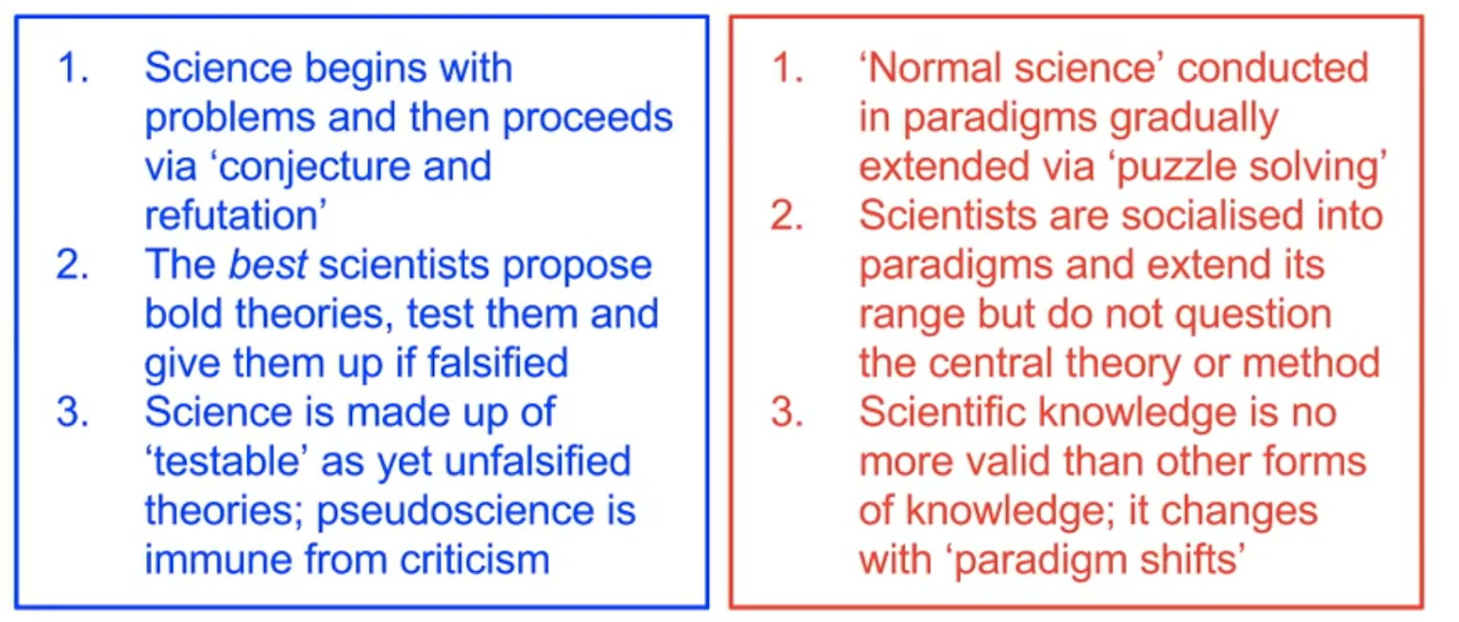
Is there such a thing as a scientific method?
What do Scientists actually do?
How is scientific knowledge different from other forms of knowledge?

Slide 14
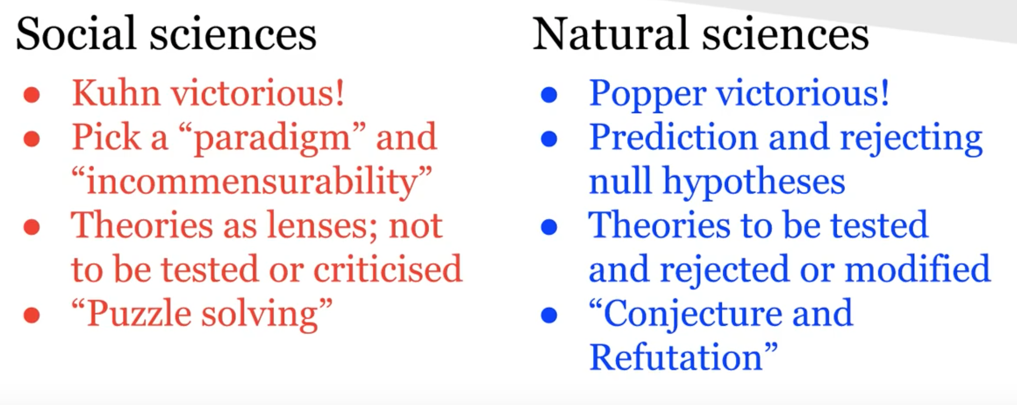
Conclusion?

